Slide 1


5 Reasons why I Should be Team Rep for the Men
By: Nicolas Germain

Slide 2
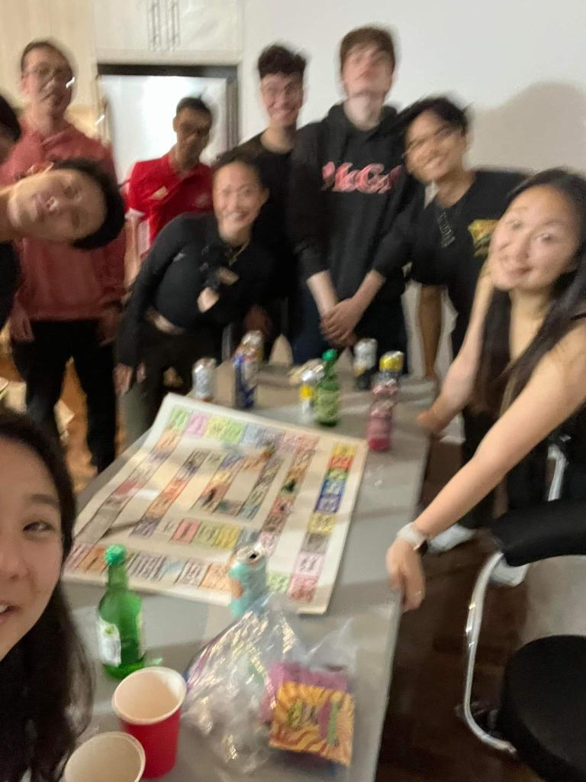
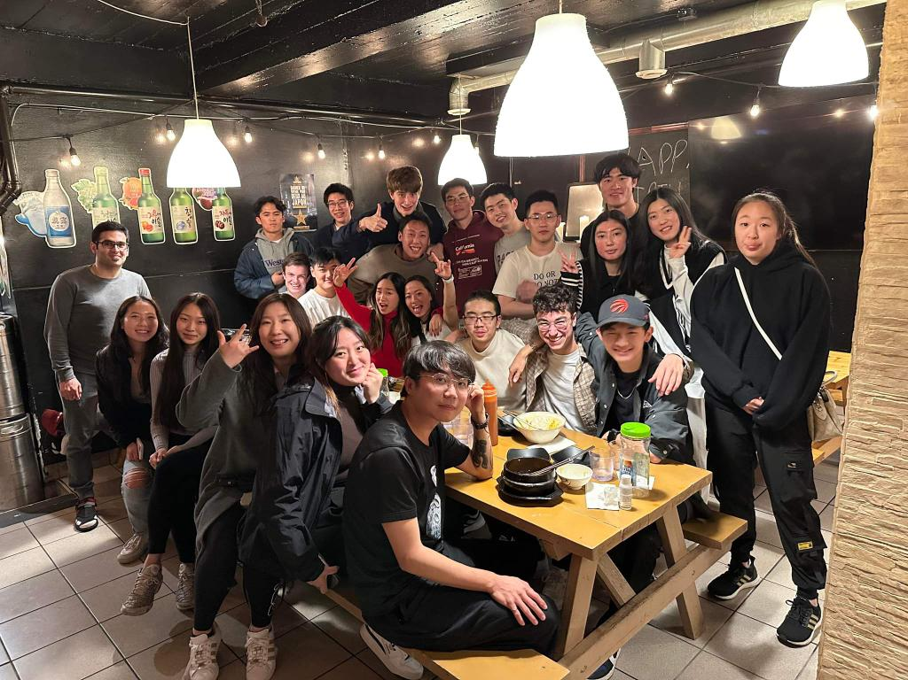
Reason #1: I am Very involved
I always try to do anything with the team
Ex: Trying to get people to go to the gym with me
I try to attend every practice (despite living 1 hour away and forgetting my alarm that 1 time).

Slide 3
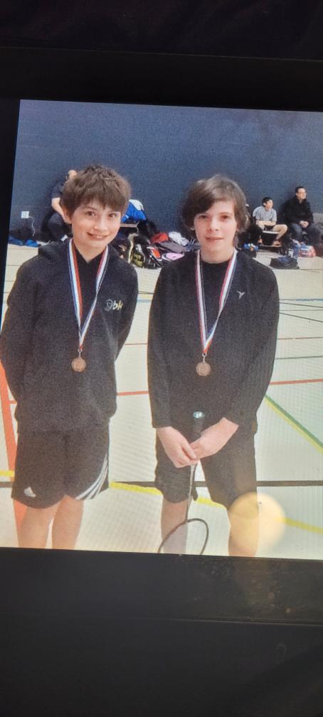
Reason#2: Passionate about the sport
Badminton has always been a part of me
Since I was 9 years
I can not think a life without the sport that I love

Slide 4

Reason#3: Easily Approachable
I love to talk to many new people ( even though I talk a lot sometimes)
I always love to bond with people (Learning about cultures, past)
I always thrive to find connections with people
I thrive when being in a group

Slide 5
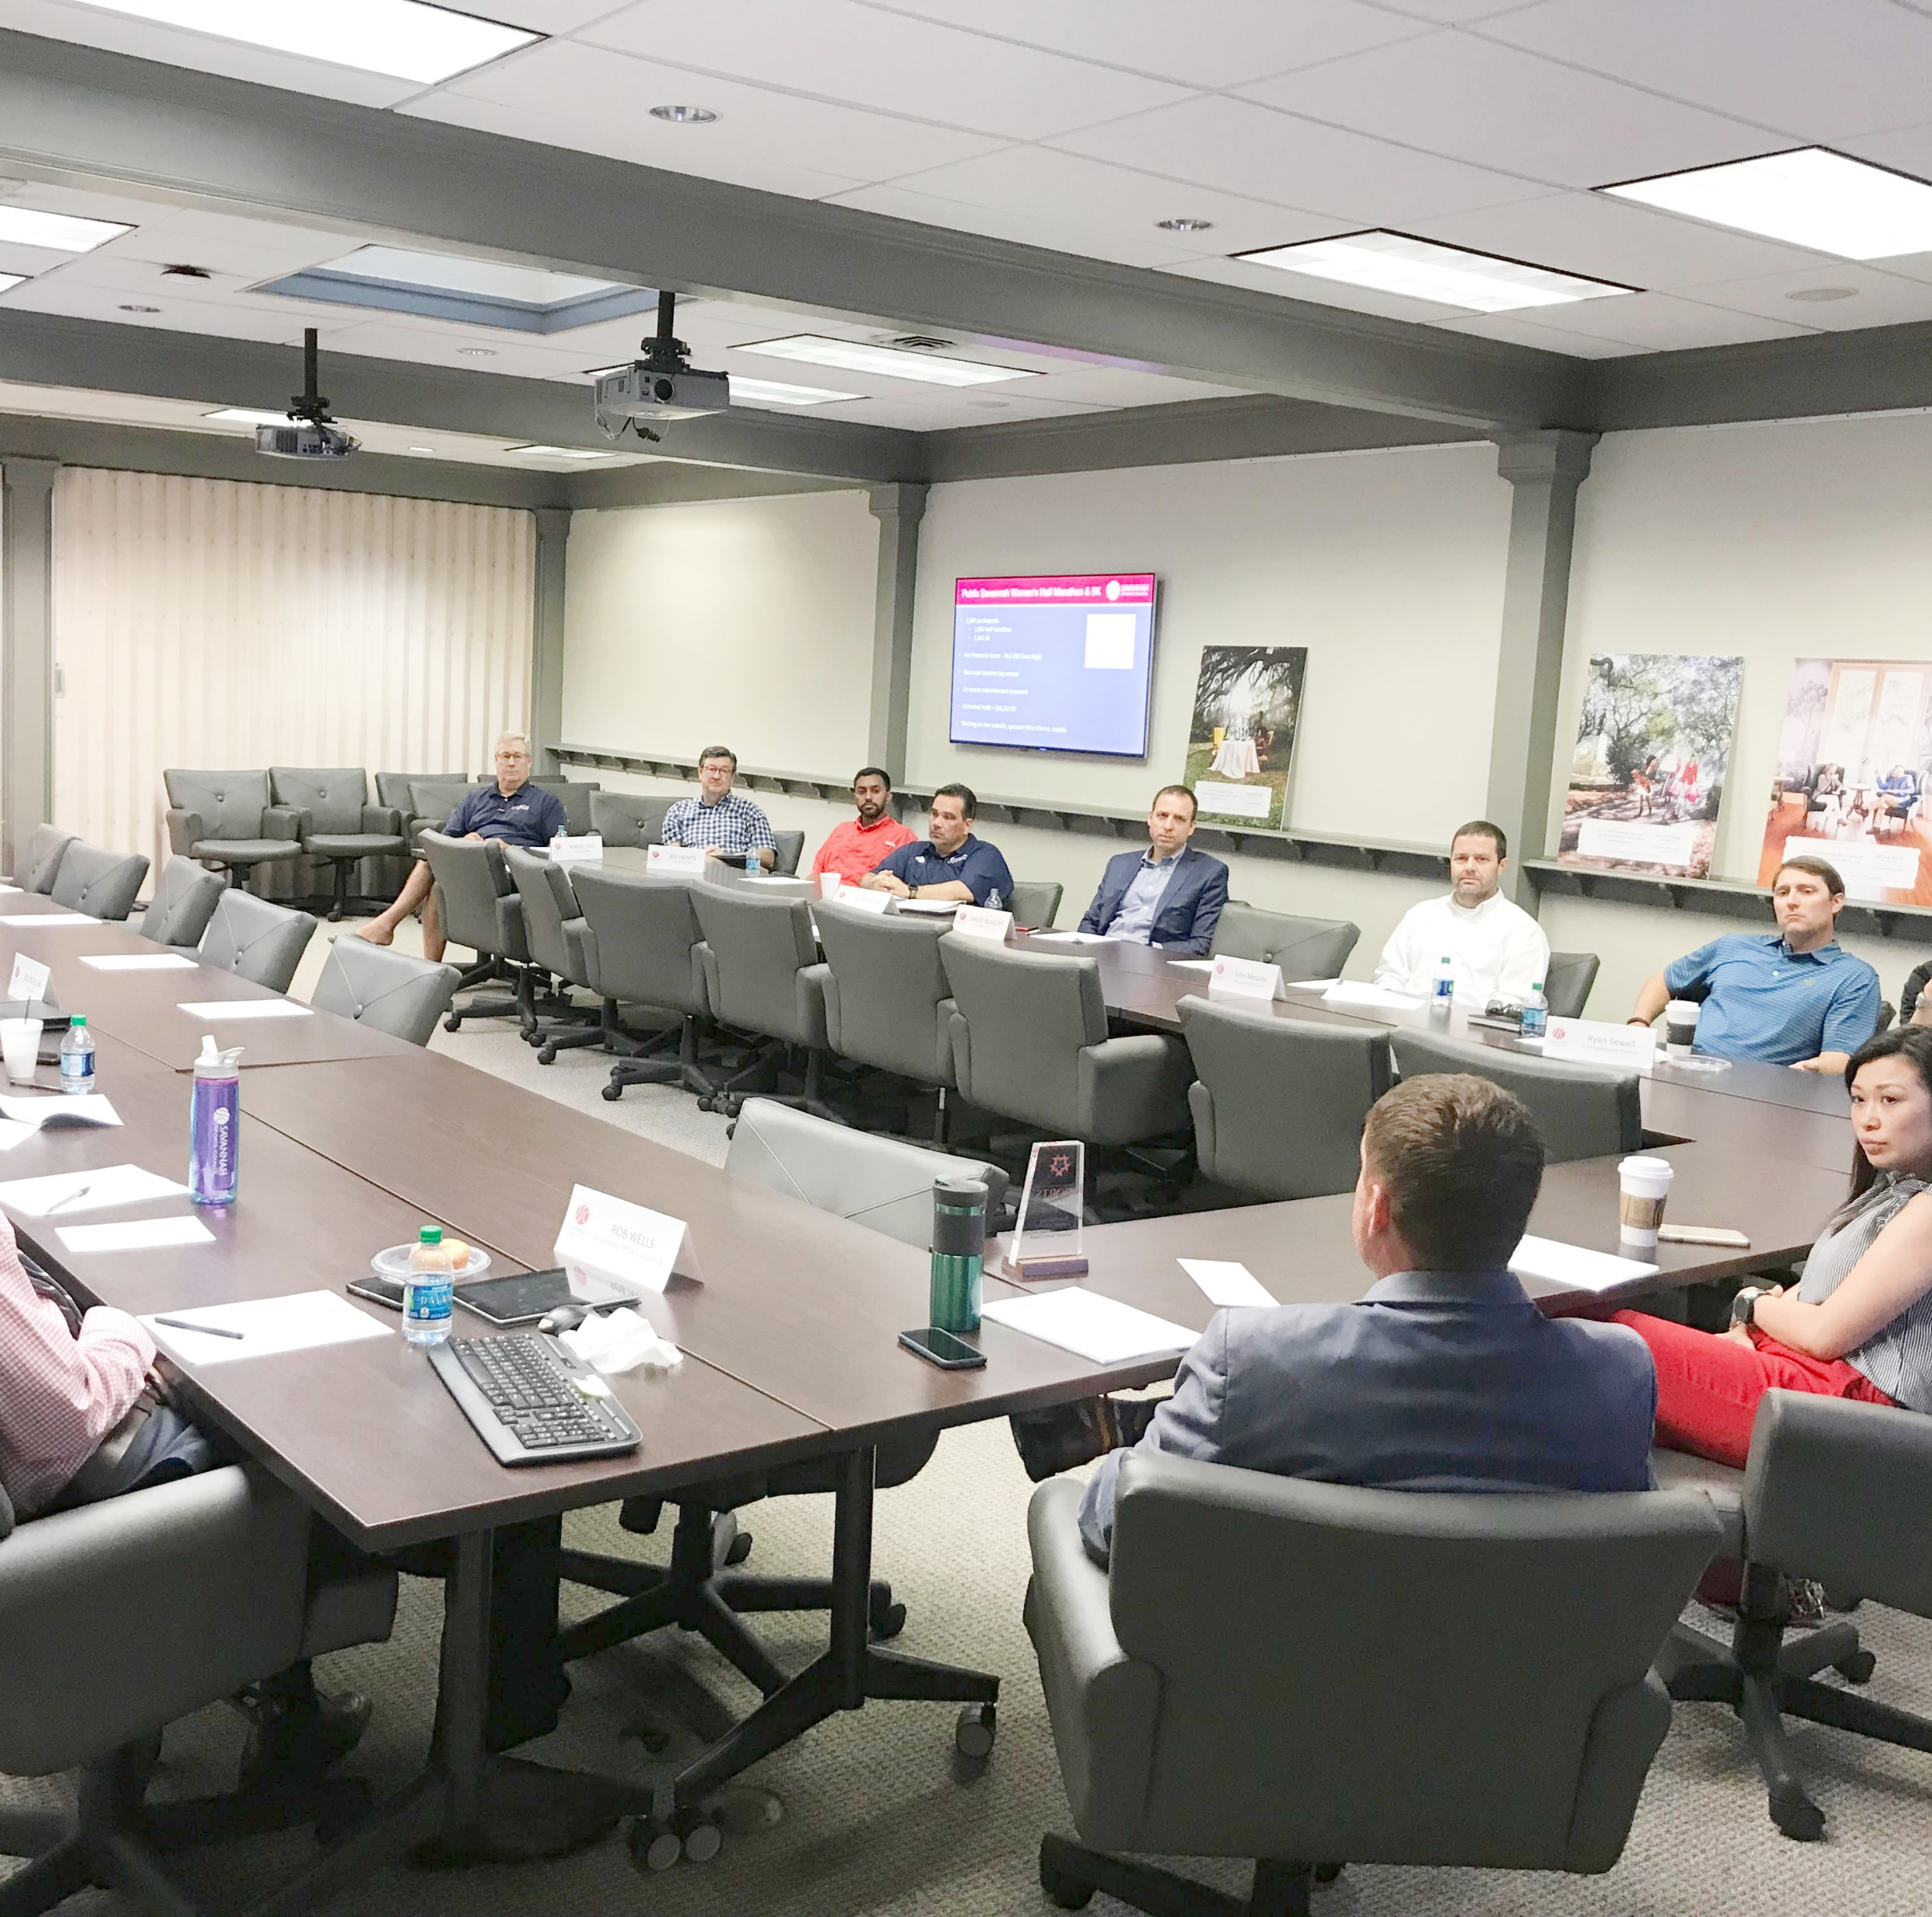
Reason#4: Trying to make a change
I would love to pitch new ideas to varsity to make life at varsity that much better
I want to change many things to the team to make us feel equal to other teams
Ex: Trying to remove at least one of the deadly 6:30 am practices, fixing the nets
TO pitch any ideas you guys want to change about our team (practices, equipment request etc.…)

Slide 6
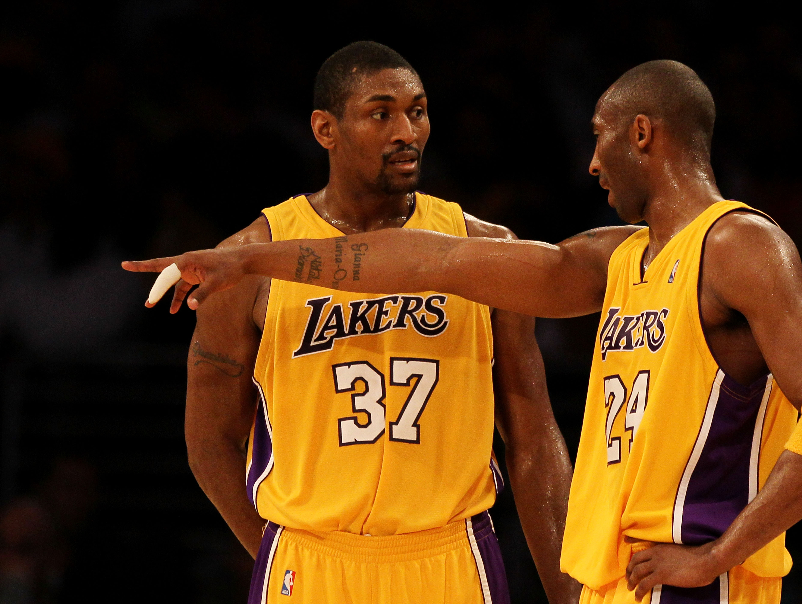
Reason #5: Pushing Myself
I like to tackle new challenges that pushes me.
I want to develop skills to be a future leader in any domain
To be Team rep would be a new challenge that I am willing to take charge of.

Slide 7

Bonus Reason

Slide 8

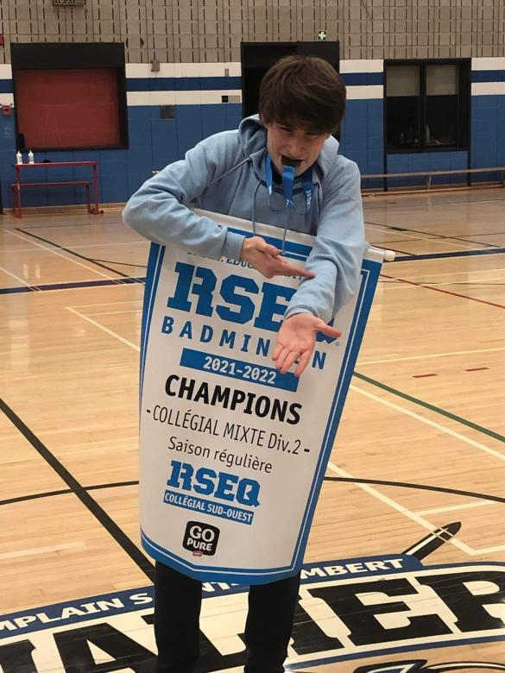
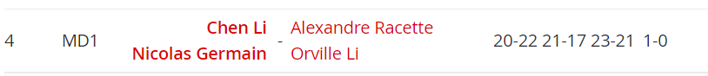

I beat Carabins Doubles #1

Slide 9
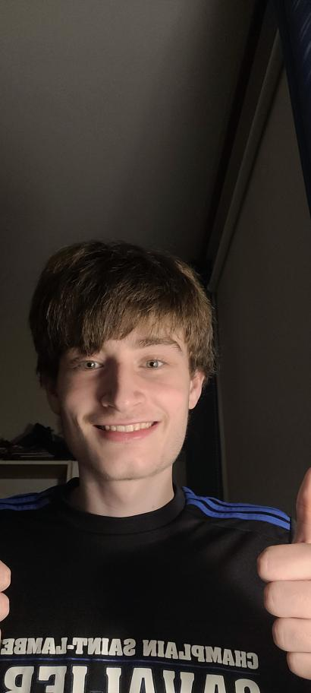
Thank You!!!

